Slide 1

Empowering 6G Communication Systems with Digital Twin Technology using ML
Carried out by
Haripriya R 4VV21EC046
Rakshitha Lakshman 4VV21EC124
Sheethal R 4VV21EC141
Swarna CN 4VV21EC165
Under the guidance of
Dr. Chaithanya DJ
Assistant Professor
Dept. of ECE

Slide 2
CONTENTS
Introduction
Literature Survey
Objective
Methodology
Hardware and Software Requirements
Results and discussion
Conclusion and future work
Publication
References

Slide 3

Introduction
Beamforming is a signal processing technique that directs the transmission or reception of signals toward a specific direction.
Cloud Processing Unit
Base Stations
Fig.1. AI-ML
Fig.2. Block Diagram Of Beamforming System

Slide 4
Literature Survey
AUTHOR NAME: | Cristina-Maria Andras, Teodora-Florentina Rîcoiu, Daniel-Alexandru Drugea, Gordana Barb, Marius Oteşteanu.
TITLE: | An Overview and Classification on Beamforming Techniques for 5G Systems
PUBLICATION DETAILS: | 07 Nov 2024
CONTENTS: | 5G technologies have opened a new chapter in the field of connectivity, offering superior speeds, reduced latency, and unprecedented opportunities for a variety of industries..

Slide 5
Literature Survey
AUTHOR NAME: | Warren Tanyaradzwa Chishiri, Krishan Kumar
TITLE: | Analysis of Beamforming Performance in 5G Communication
PUBLICATION DETAILS: | 23 Jun 2024
CONTENTS: | Beamforming is described as a technique that utilizes multiple radiating elements to create a focused signal, which is crucial for improving the efficiency and effectiveness of data transmission in 5G networks. This method allows for a more directed signal, which can lead to better coverage and reduced interference

Slide 6
Literature Survey
AUTHOR NAME: | Hequn Zhu, Kun Huang, Wensi Zhao, Long Xiao, Huichao Yang.
TITLE: | Comparison of Beamforming Algorithms in 5G Mobile Scenarios.
PUBLICATION DETAILS: | 28 Oct 2024
CONTENTS: | Beamforming technology is a key technology of 5G, which can effectively improve the spectrum efficiency and system capacity through the aggregation of the transmitted signal energy, and has been widely used in practical engineering.

Slide 7
Literature Survey
AUTHOR NAME: | Nikolaos Apostolakis, Livia Elena Chatzieleftheriou, Dario Bega, Marco Gramaglia,
TITLE: | Digital Twins for Next-Generation Mobile Networks
PUBLICATION DETAILS: | 01 Jan 2023
CONTENTS: | Digital Twins (DTs) create fully-synchronized virtual representations of real-world systems, which can serve as interactive counterparts for artificial intelligence (AI) and machine learning (ML) algorithms, and hold significant importance for the upcoming 6G mobile networks.

Slide 8
Literature Survey
AUTHOR NAME: | Emmanuel Ekene Okere,Vipin Balyan
TITLE: | Sixth Generation Enabling Technologies and Machine Learning Intersection: A Performance Optimization Perspective
PUBLICATION DETAILS: | 21 Jan 2025
CONTENTS: | The fifth generation (5G) of wireless communication is in its finalization stage and has received favorable reception in many nations. However, research is now geared towards the anticipated sixth-generation (6G) wireless network. The new 6G promises even more severe performance criteria than the current 5G generation.

Slide 9
Objective
To Design an architecture to dynamically optimize beamforming patterns in 5G/6G networks, improving signal quality, user experience, and network efficiency.

Slide 10
Methodology
Load data set
Pre-processes and feature selection
Train SVR and NN model
Test SVR and NN model
Prediction in real time
Fig.3. Working Block Diagram.

Slide 11
Hardware and Software Requirements
Software Requirements
TensorFlow or PyTorch
Scikit-learn
Keras
NumPy and Pandas
Matplotlib and Seaborn
GNU Radio
NS-3 (Network Simulator 3)
Jupyter Notebook

Slide 12
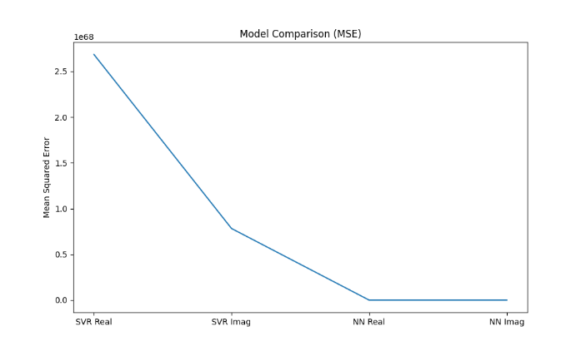
Results and discussion
Fig.5. Model Comparison.

Slide 13
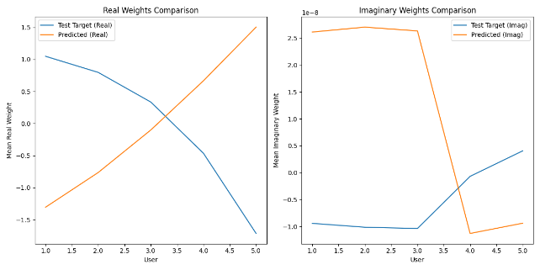
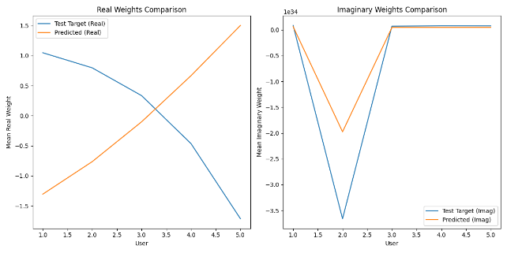
Results and discussion
Fig.6. NN Weights Comparison.
Fig.7. SVR Weights Comparison.

Slide 14
Conclusion and future work
Future work includes the implementation of a graphical user interface
GUI is the visual part of a software application that users interact with—like buttons, windows, icons, and menus, rather than using text-based commands.

Slide 15
References
[1] M. Giordani, M. Polese, A. Roy, D. Castor, and M. Zorzi, “A tutorial on beam management for 3GPP NR at mmWave frequencies,” IEEE Communications Surveys & Tutorials, vol. 21, no. 1, pp. 173–196, 2019.
[2] W. Chen, J. Montojo, J. Lee, M. Shafi, and Y. Kim, “The standardization of 5G-Advanced in 3GPP,” IEEE Communications Magazine, vol. 60, no. 11, pp. 98–104, 2022.
[3] G. C. Alexandropoulos, K. Stylianopoulos, C. Huang, C. Yuen, M. Ben nis, and M. Debbah, “Pervasive machine learning for smart radio en vironments enabled by reconfigurable intelligent surfaces,” Proceedings of the IEEE, vol. 110, no. 9, pp. 1494–1525, 2022.

Slide 16
References
[4] X. Lin, “An overview of the 3GPP study on artificial intelligence for 5G new radio,” 2023. [Online]. Available: https://arxiv.org/abs/2308.05315
[5] 3GPP RP-213599, “New SI: Study on artificial intelligence (AI)/machine learning (ML) for NR air interface,” Tech. Rep., TSG RAN Meeting #94e, Qualcomm (Moderator), Dec. 2021.
[6] Q. Xue, C. Ji, S. Ma, J. Guo, Y. Xu, Q. Chen, and W. Zhang, “A survey of beam management for mmWave and THz communications towards 6G,” IEEE Communications Surveys & Tutorials, pp. 1–1, 2024.
[7] H. Jin, K. Liu, M. Zhang, L. Zhang, G. Lee, E. N. Farag, D. Zhu, E. Ong gosanusi, M. Shafi, and H. Tataria, “Massive MIMO evolution toward 3GPP release 18,” IEEE Journal on Selected Areas in Communications, vol. 41, no. 6, pp. 1635–1654, 2023.

Slide 17


